Slide 1
Singleton Design Pattern

Slide 2
Introduction
The Singleton pattern ensures that a class has only one instance and provides a global point of access to it
It is a design pattern that restricts the instantiation of a class to one object

Slide 3
Examples
A single DB connection shared by multiple objects as creating a separate DB connection for every object may be costly
There should be only one instance of file system

Slide 4
Creating Singleton design pattern
It requires static members of class, private constructor and static factory method
Static member: instance of singleton class
Private constructor: preventing from initializing the singleton class
Static factory method: provides global point of access to singleton object and returns instance to the caller

Slide 5
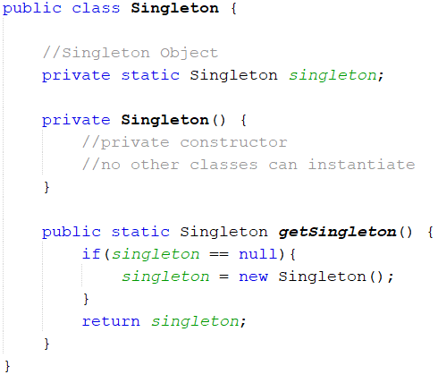
Creating Singleton
A static private variable to hold the singleton
Private Constructor, So outside classes can not instantiate
A static getter method returns singleton instance

Slide 6
Two ways of singleton design pattern
Eager Instantiation: In this method, class is initialized whether it is to be used or not. Instance is created at run time
Lazy Instantiation: In this method, class in initialized only when it is required. It can save you from instantiating the class when you don’t need it

Slide 7
Eager Instantiation
Very common implementation
Instance is created for a class at the time of declaring the static data member
Drawback:
Static object is created when class is loaded and it will be on memory even if we not use

Slide 8
Example
public class Singleton {
//Eager, instance is created at load time
private static Singleton obj = new Singleton();
private Singleton(){}
public static Singleton getInstance(){
return obj;
}
}

Slide 9
Lazy Instantiation
Delaying the initialization
Instance of class is created in synchronized method when required

Slide 10
Example
public class Singleton {
private static Singleton obj;
private Singleton() {}
public static Singleton getInstance() {
if (obj == null) { obj = new Singleton(); }
return obj;
}
}

Slide 11
Problem with Lazy Instantiation
Above example is not thread safe because if we have multi threaded environment there will be case where multiple threads are inside the if condition at the same time. It will destroy the singleton pattern and both threads will get different instances

Slide 12
Thread safe Singleton
public class Singleton {
private static Singleton obj;
private Singleton() {}
public static synchronized Singleton getInstance() {
if (obj == null) { obj = new Singleton(); }
return obj;
}
}

Slide 13
Lazy instantiation with Double-checking locking
Double checking locking principle is used to increase performance for Lazy instantiation
This approach uses synchronized block inside the if condition with an additional check to ensure that only one instance of singleton class is created

Slide 14
Double-checked locking implementation
public static Singleton getInstance() {
if (obj == null) {
synchronized (Singleton.class) {
if (obj == null) { obj = new Singleton(); }
}
}
return obj;
}

Slide 15
Enum Singleton
Enum type can be used to implement Singleton design pattern
Enum value is instantiated only once and globally accessible
Does not allow lazy initialization
Implicit support for thread safety

Slide 16
Example
public enum SingletonEnum {
INSTANCE;
}

Slide 17
Advantages and Usage
Advantages
Saves memory because object is not created at each request
Only single instance is reused again
Usage
Used in multi-threaded and database applications
Used in logging, caching, thread pools, configuration settings etc

Slide 18
References
https://www.journaldev.com/1377/java-singleton-design-pattern-best-practices-examples
https://www.javatpoint.com/singleton-design-pattern-in-java

Slide 19
Singleton Design Pattern
The End

